Slide 1
Payment Default Prediction
Shantanu Rathore

Slide 2
5.4%
The rate of credit card delinquencies for small banks this year - the highest since the financial crisis of 2008-09 and this number is expected to grow

Slide 3
Objective
The objective,is to build a model which is able to identify clients who can potentially default on their credit card payment based on their payment details for the last six months.
Following the analysis as well as deciding on a model to use for the prediction, the bank can then take a number of measures to ensure or increase the chances of payments or prepare for delays. Considering the fact that any such measure will incur a cost to the bank, the model which will have the highest return for the bank will be chosen.

Slide 4
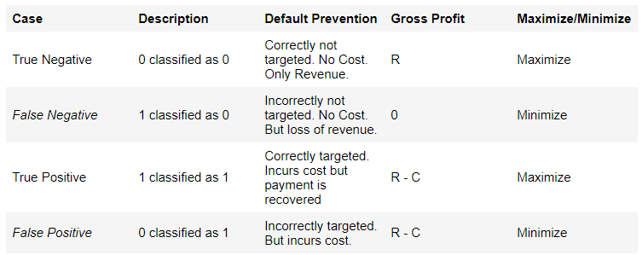
Methodology
In this classification problem, 1 ~ the customer will default and 0 ~ the customer will not default. Assuming the average cost for running the default prevention campaign is C and the average revenue recovered from each customer is R, the bank has to minimize C and maximize R.

Slide 5
Assumptions and Limitations
Assumptions
The success rate of the default prevention campaign is assumed to be 100% for the sake of simplicity i.e. every customer who is reached out to, will not default on his or her payment.
Limitations
The features are limited in their variety. Additional features like customer credit scores, credit history, region, annual income, number of dependents etc. can have a significant impact on the model
- The data set is small - Ideally, credit card data sets are very large with millions of customers
- This kind of data would not be useful for new customers coming to the bank as the bank would possibly not have the person past financial data. (another reason to obtain a richer feature set)

Slide 6
Data Set Description
The data set was obtained from the location : [https://archive.ics.uci.edu/ml/datasets/default+of+credit+card+clients]
The total number of observations is 30000 rows and 25 features (including the target feature)
The data set is highly unbalanced - only 22% of the observations are customers who default (1)
The 25 columns or features are a mix of numerical and categorical data types

Slide 7
Models and Model Evaluation
kNN (k Nearest Neighbours)
Logistic Regression
Decision Tree Classification
Random Forests
Model Evaluation has been done on the basis of the following
Accuracy
Confusion Matrix
ROC Curve
Precision and recall
Cost benefit analysis

Slide 8
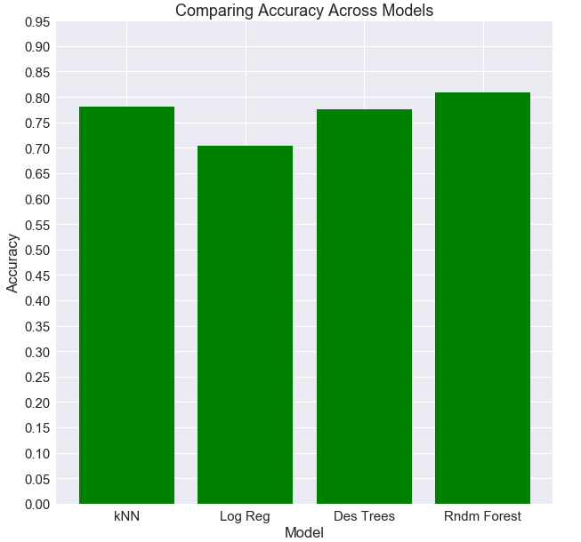
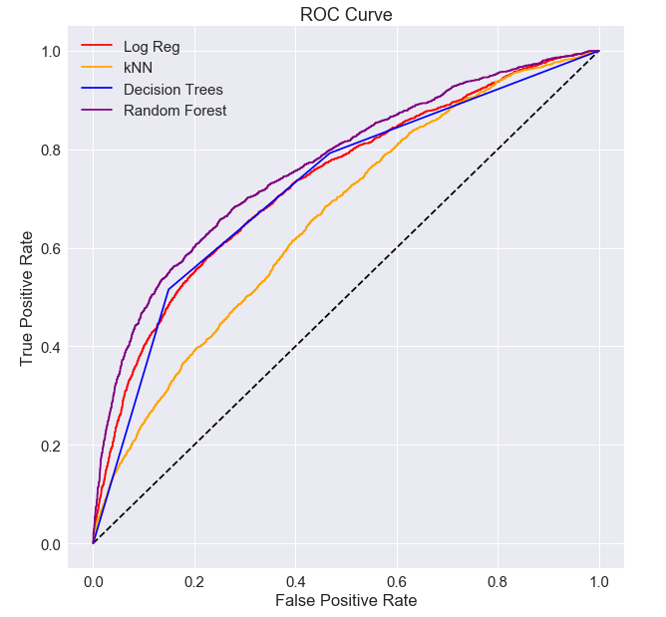
Results

Slide 9
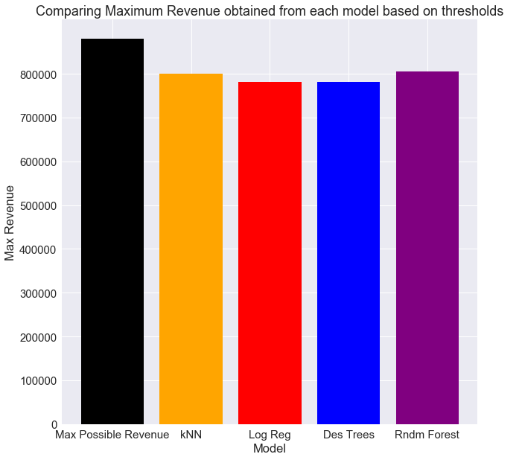
Results and Conclusion
The model which uses Random Forest for prediction gives us the maximum revenue.
Minimizing the number of false positives and maximizing the number of true negatives was important for us in this scenario, as we try to correctly target the people who will default which in turn saves money spent towards any program to maximize the potential of a payment.

